Slide 1
Advanced Communication Lab
P.RAJESH
Dept of E.C.E
JNTUA CE ANANTAPUR

Slide 2
Course Objective:
• To generate random data at given rates and employ different modulation schemes over generated data.
• To simulate different modulated signals and diversity schemes over AWGN, and estimate data reception using different algorithms.
• To implement RAKE receiver and estimate its performance through BER curve.

Slide 3
COMMUNICATION SYSTEMS
TRANSMITTER SYSTEM
DATA
RECEVIER
SYSTEM

Slide 4
COMMUNICATION SYSTEMS
Generation of Random data at a given data rate (Hardware & Software) –
(M-Sequence).
Interference
Generation
of
DATA
Transmitter System
Fading
Noise
Estimation
RECEVIER
SYSTEM

Slide 5
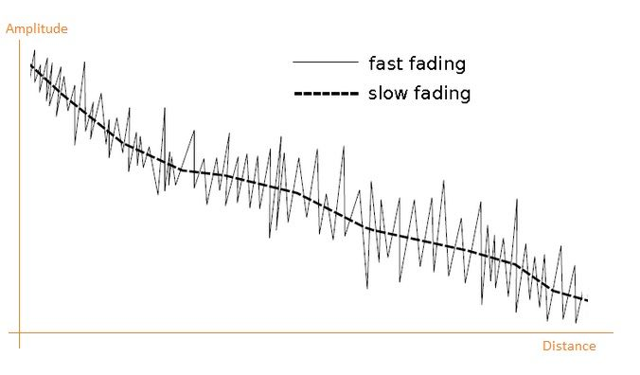
SYSTEM
Using M-Sequence
GENERATION OF DATA
Fading
Fading : Time variant features leads to particular phenomenon called fading.
→ fading a deviation which effects a signal during propagation caused by interference between 2 (or) more version of Tx signal which arrive at receiver at slight different time.

Slide 6
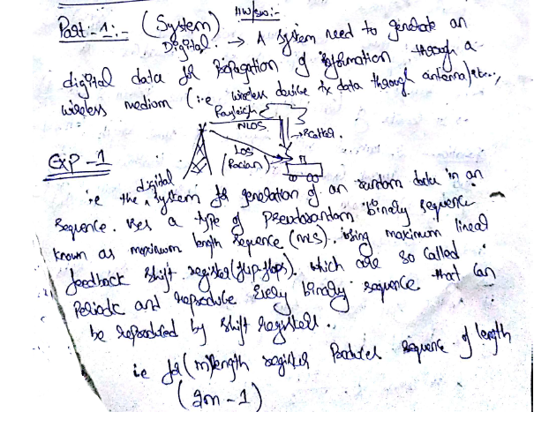

Slide 7
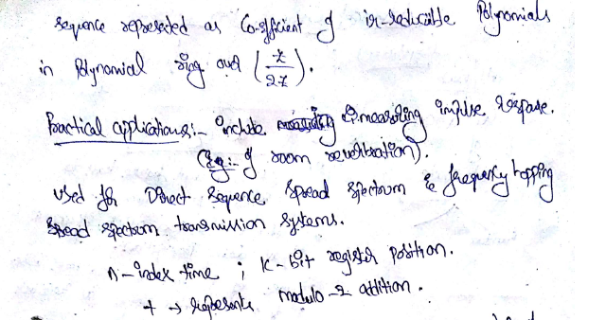

Slide 8
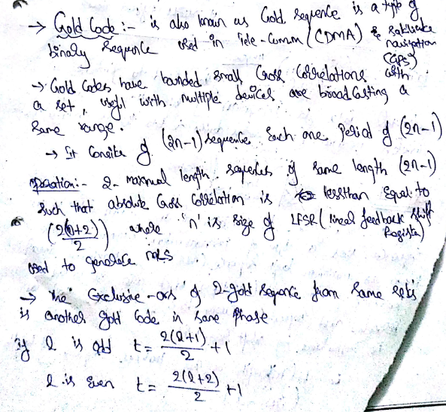

Slide 9
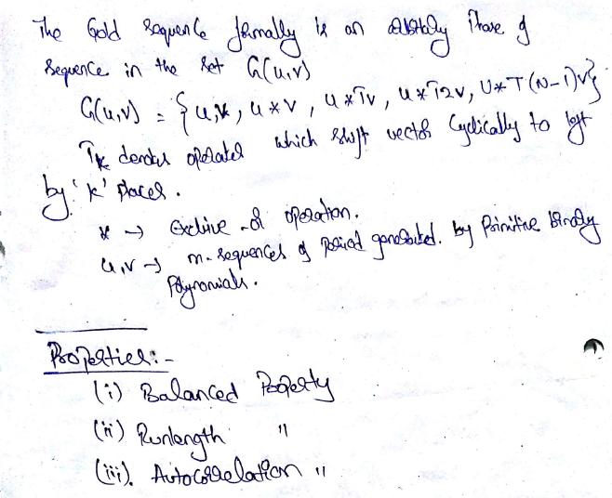

Slide 10
2. Simulation of Rayleigh fading channel incorporating speed of the mobile & Power delay profile
Interference
1. Generation
of
DATA
Transmitter System
Fading
Noise
Estimation
RECEVIER
SYSTEM
2. Rayleigh Fading
Controls Speed & Power Delay
Rician fading or Ricean fading

Slide 11
Rician fading or Ricean fading
is a stochastic model for radio propagation anomaly caused by partial cancellation of a radio signal by itself —the signal arrives at the receiver by several different paths (hence exhibiting multipath interference), and at least one of the paths is changing (lengthening or shortening).
Rician fading occurs when one of the paths, typically a line of sight signal or some strong reflection signals, is much stronger than the others. In Rician fading, the amplitude gain is characterized by a Rician distribution.
Rayleigh fading
is sometimes considered a special case of Rician fading for when there is no line of sight signal. In such a case, the Rician distribution, which describes the amplitude gain in Rician fading, reduces to a Rayleigh distribution. Rician fading itself is a special case of two-wave with diffuse power (TWDP) fading.

Slide 12
Interference
1. Generation
of
DATA
Transmitter System
Fading
Noise
Estimation
RECEVIER
SYSTEM
Racian Fading
→ Dominant (LOS)
2. Rayleigh Fading
Scattered Propagation (NLOS)
Controls Speed & Power Delay

Slide 13
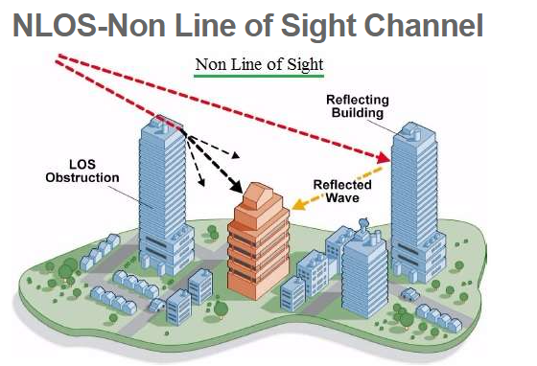
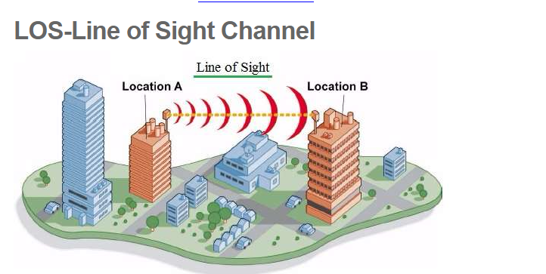
line of sight communication between two transceivers. This LOS deployment is possible when there is no obstruction between base station (BS) and mobile/fixed subscriber stations (SSs). In other words, LOS communication is possible when there is no obstruction between transmitter and receiver. Due to less attenuation in the LOS communication, it offers good signal strength and higher amount of throughput compare to NLOS counterpart.
As shown, wireless link is considered to be NLOS when natural and/or man made structures block the path between base station and subscriber stations. In other words, NLOS communication is possible even when there is obstruction between transmitter and receiver. The signal arrives to the receiver after going through many obstructions in between. On the path, signal goes through attenuations as well as reflection, diffraction as well as penetrations.

Slide 14
3. Simulation of BPSK system over AWGN channel & finding its performance with BER plot.
Interference
1. Generation
of
DATA
AWGN (Additive White Gaussian Noise )
Transmitter System
Fading
Noise
Estimation
RECEVIER
SYSTEM
3. BPSK system over AWGN Channel finalizing performance with BER

Slide 15
Binary Phase Shift Keying (BPSK) is a two phase modulation scheme, where the 0’s and 1’s in a binary message are represented by two different phase states in the carrier signal: for binary 1 and for binary 0.
Additive white Gaussian noise (AWGN) is a basic noise model used in information theory to mimic the effect of many random processes that occur in nature.
Additive because it is added to any noise that might be intrinsic to the information system.
White refers to the idea that it has uniform power across the frequency band for the information system. It is an analogy to the color white which has uniform emissions at all frequencies in the visible spectrum.
Gaussian because it has a normal distribution in the time domain with an average time domain value of zero.
The bit error rate (BER) is the number of bit errors per unit time. The bit error ratio (also BER) is the number of bit errors divided by the total number of transferred bits during a studied time interval. Bit error ratio is a unitless performance measure, often expressed as a percentage.^{[1]}
The bit error probability p_{e} is the expectation value of the bit error ratio. The bit error ratio can be considered as an approximate estimate of the bit error probability. This estimate is accurate for a long time interval and a high number of bit errors.

Slide 16
4. Implementation of Equalization at the receiver to remove ISI caused due to Low channel bandwidth
4. Implementing Equalization at Receiver to remove ISI due to low channel Band Width
Interference
1. Generation
of
DATA
AWGN
Transmitter System
Fading
Noise
Estimation
RECEVIER
SYSTEM

Slide 17
Inter symbol interference (ISI) is a form of distortion of a signal in which one symbol interferes with subsequent symbols.
This is an unwanted phenomenon as the previous symbols have similar effect as noise, thus making the communication less reliable.
The spreading of the pulse beyond its allotted time interval causes it to interfere with neighboring pulses.^{[1]}
ISI is usually caused by multipath propagation or the inherent linear or non-linear frequency response of a communication channel causing successive symbols to "blur" together.
The presence of ISI in the system introduces errors in the decision device at the receiver output. Therefore, in the design of the transmitting and receiving filters, the objective is to minimize the effects of ISI, and thereby deliver the digital data to its destination with the smallest error rate possible.

Slide 18
5. Simulation of CDMA signal using QPSK modulation scheme &obtain matched filter response over AWGN Channel
Interference
1. Generation
of
DATA
AWGN
Transmitter System
Fading
Noise
Estimation
RECEVIER
SYSTEM
5. CDMA signal using QPSK modulation scheme & obtain matched filter response over AWGN

Slide 19
CDMA is a channel access method used by various radio communication technologies CDMA is an example of multiple access, where several transmitters can send information simultaneously over a single communication channel. This allows several users to share a band of frequencies (see bandwidth). To permit this without undue interference between the users, CDMA employs spread spectrum technology and a special coding scheme (where each transmitter is assigned a code)
CDMA is used as the access method in many mobile phone standards. IS-95, also called "cdmaOne", and its 3G evolution CDMA2000, are often simply referred to as "CDMA", but UMTS, the 3G standard used by GSM carriers, also uses "wideband CDMA", or W-CDMA, as well as TD-CDMA and TD-SCDMA, as its radio technologies.
Quadrature Phase Shift Keying (QPSK) Sometimes this is known as quadriphase PSK, 4-PSK, or 4-QAM. QPSK is a form of Phase Shift Keying in which two bits are modulated at once, selecting one of four possible carrier phase shifts (0, 90, 180, or 270 degrees). QPSK allows the signal to carry twice as much information as ordinary PSK using the same bandwidth.

Slide 20
6. Implementation of RAKE receiver & finding its performance through BER Curve
Interference
1. Generation
of
DATA
AWGN
Transmitter System
Fading
Noise
Estimation
RECEVIER
SYSTEM
6. Implementation of Rake Receiver & finding its performance through BER curve

Slide 21
A rake receiver is a radio receiver designed to counter the effects of multipath fading. It does this by using several "sub-receivers" called fingers, that is, several correlators each assigned to a different multipath component. Each finger independently decodes a single multipath component; at a later stage the contribution of all fingers are combined in order to make the most use of the different transmission characteristics of each transmission path. This could very well result in higher signal-to-noise ratio (or E_{b}/N₀) in a multipath environment than in a "clean" environment.
The multipath channel through which a radio wave transmits can be viewed as transmitting the original (line of sight) wave pulse through a number of multipath components. Multipath components are delayed copies of the original transmitted wave traveling through a different echo path, each with a different magnitude and time-of-arrival at the receiver.

Slide 22
7. Implementation of L.M.S algorithm to estimate the original data when it is corrupted by noise & channel.
Interference
1. Generation
of
DATA
AWGN
Transmitter System
Fading
Noise
Estimation
RECEVIER
SYSTEM
For Original Data
→ (i) LMS algorithm to estimate original data when corrupted by noise channel

Slide 23
Adaptive Noise cancellation (ANC) : Adaptive Noise Cancellation is an alternative technique of estimating signals corrupted by additive noise or interference.
Its advantage lies in that, with no apriori estimates of signal or noise, levels of noise rejection are attainable that would be difficult or impossible to achieve by other signal processing methods of removing noise.
Its cost, inevitably, is that it needs two inputs - a primary input containing the corrupted signal and a reference input containing noise correlated in some unknown way with the primary noise.
The reference input is adaptively filtered and subtracted from the primary input to obtain the signal estimate. Adaptive filtering before subtraction allows the treatment of inputs that are deterministic or stochastic, stationary or time-variable.

Slide 24
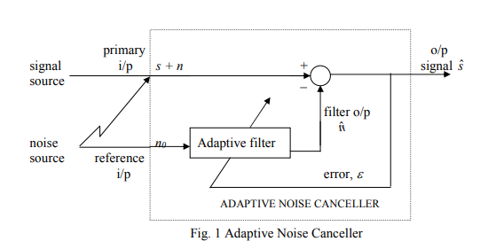

Slide 25
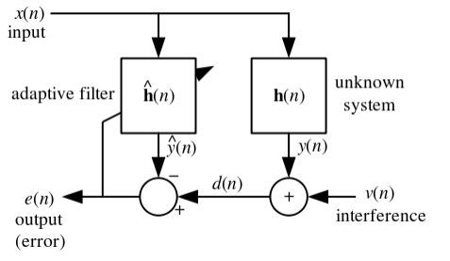
Least mean squares (LMS) algorithms are a class of adaptive filter used to mimic a desired filter by finding the filter coefficients that relate to producing the least mean square of the error signal (difference between the desired and the actual signal).

Slide 26
8. Implementation of R.L.S algorithm to estimate the original data when it is corrupted by noise & channel.
Interference
1. Generation
of
DATA
AWGN
Transmitter System
Fading
Noise
Estimation
RECEVIER
SYSTEM
8. For Original Data
→ (ii) RLS algorithm to estimate original data when it is corrupted by noise & channel

Slide 27
Recursive least squares (RLS) is an adaptive filter algorithm that recursively finds the coefficients that minimize a weighted linear least squares cost function relating to the input signals.
This approach is in contrast to other algorithms such as the least mean squares (LMS) that aim to reduce the mean square error.

